Slide 1
Yen Phu 2 Primary School
Dương Quang Primary School
Welcome to grade 3
Teacher: Mrs Lý

Slide 2
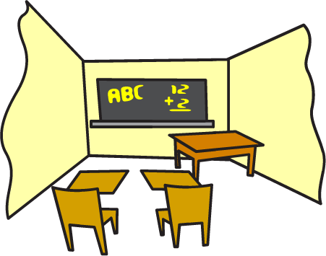
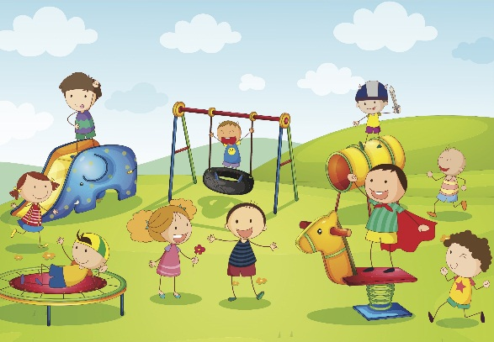
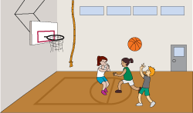
computer room
classroom
library
playground
gym

Slide 3
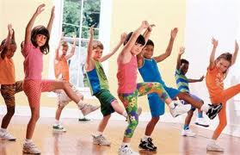
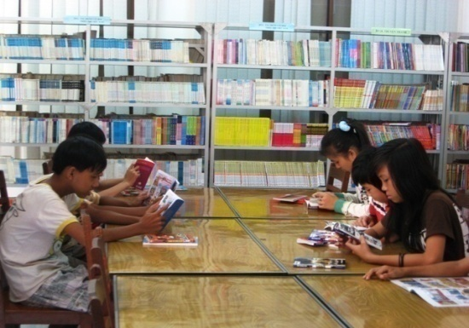
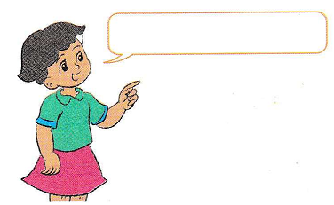
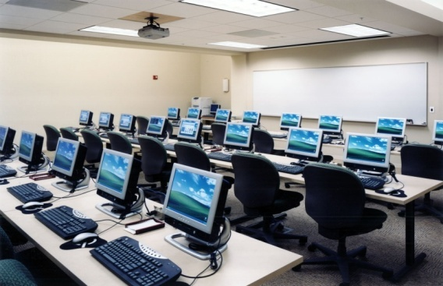
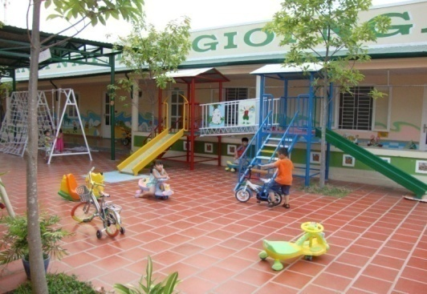
That’s the…
gym
library
computer room
playground

Slide 4
Let’s listen
Textbook P.45

Slide 5
Warm up

Slide 6
Lucky number
1
2
3
4
5
6
7
8
9

Slide 7
Number 1: What is this?
Classroom

Slide 8
Number 2: What is this?
Gym

Slide 9
Number 3: What is this?
Playground

Slide 10
Number 4: What’s it like?
Big and small

Slide 11
Number 5: What is this?
Computer room

Slide 12
Number 6
Lucky number

Slide 13
Number 7: What’s it like?
Large

Slide 14
Number 8: What is this?
Library

Slide 15
Number 9
Lucky number

Slide 16
New words New: Mới Old: Cũ

Slide 17
Matching
Classroom
Large
New
Old
Big
Small
Gym
Cũ
Mới
Nhỏ
Phòng học
Phòng tập thể thao
Rộng
Lớn

Slide 18
New words
classroom
old: cũ
new: mới
large rộng
gym
library
computer room

Slide 19
1. Look, listen and repeat

Slide 20
Model sentence
Is your school big?
Yes, it is.
No, it isn’t. It’s small.

Slide 21
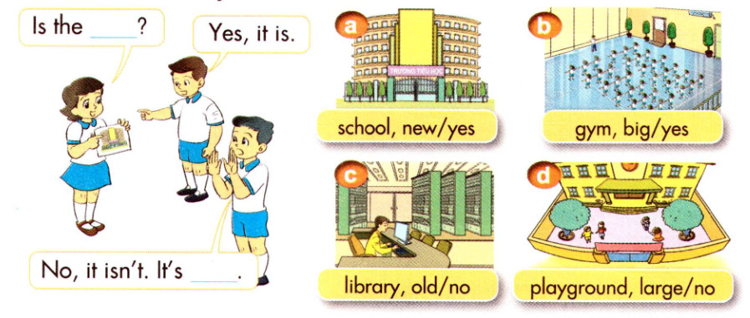
2. Point and say

Slide 22
LET’S SAY
A: Is the school new?
B: Yes, it is

Slide 23
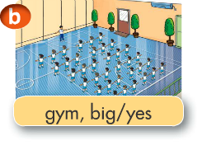
Let’s say
A: Is the gym big?
B: Yes, it is

Slide 24
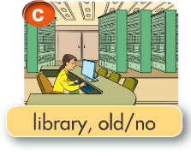
Let’s say
A: Is the library old?
B: No. It isn’t. It’s new.

Slide 25
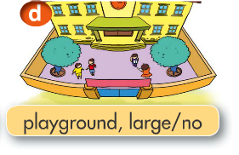
Let’s say
A: Is the playground large?
B: No. It isn’t. It’s small.

Slide 26
3. Let’s talk

Slide 27
Homework
Practice more
Learn vocabulary, model sentence by heart.
Prepare next lesson: Unit 7: Lesson 2: 4, 5,6.

